Slide 1


A Seminar on
“ Dart Programming ”
Submit For Partial Fulfil for The Degree Of
Bachelor Of Computer Application
6th Semester Tybca
Year: 2020-21
Submitted To
M. K. INSTITUTE OF COMPUTER STUDIES BHARUCH
INTERNAL GUIDANCE: Paresh Prajapati
SUBMITTED BY: Vikram Somai
EXAM SEAT NO: -1425

Slide 2
ACKNOWLEDGEMENTS
I take this opportunity to express our profound sense of gratitude and respect to all those who helped us throughout the duration of this seminar.
Firstly, I am extremely grateful to M.K INSTITUTE OF COMPUTER STUDIES, BHARUCH, for providing the excellent working environment to undergo my seminar. I would like to devote our success in this effort to our Seminar guide MR PARESH PRAJAPATI, for giving me the opportunity to undertake the project and providing crucial feedbacks that influenced us and provided opportunity to undertake the seminar work in the esteemed concern.
I am deeply thankful to Prof. MR PARESH PRAJAPATI, whose useful suggestions, gentle soothing attitude and right directions helped us a lot to learn in this seminar and also for his constant encouragement and support throughout the project. Last, but not least I would like to extend my profound thanks to all our esteemed Colleagues and friends at college level who helped us in the specific areas of this Seminar.
by:Vikram Somai

Slide 3
ABSTRACT
Dart is an open-source, general-purpose, object-oriented programming language with C-style syntax developed by Google in 2011.
The purpose of Dart programming is to create a frontend user interfaces for the web and mobile apps.
It is under active development, compiled to native machine code for building mobile apps, inspired by other programming languages such as Java, JavaScript, C#, and is Strongly Typed. Since Dart is a compiled language so you cannot execute your code directly; instead, the compiler parses it and transfer it into machine code.

Slide 4
No | Index | Page No
1 | Introduction | 3
2 | History | 4
3 | Why dart | 5
4 | Features | 6
5 | Installation | 12
6 | First program | 19
7 | Advantages and disadvantages | 23
8 | Conclusion | 27
9 | Bibliography | 28

Slide 5
Introduction
Dart is a general-purpose, high-level modern programming language which is originally developed by Google.
It is the new programming language which is emerged in 2011, but its stable version was released in June 2017.
Dart is not so popular at that time, but It gains popularity when it is used by the Flutter.
Dart is a dynamic, class-based, object-oriented programming language with closure and lexical scope. Syntactically, it is quite similar to Java, C, and JavaScript. If you know any of these programming languages, you can easily learn the Dart programming language.
Dart is an open-source programming language which is widely used to develop the mobile application, modern web-applications, desktop application, and the Internet of Things (IoT) using by Flatter framework. It also supports a few advance concepts such as interfaces, mixins, abstract classes, refiled generics, and type interface.

Slide 6
History
Dart was revealed for the first time in the GOTO conference in the month of 10th - 12th October 2011 at Aarhus, Denmark. It is initially designed by the Lars bark and Kespar and developed by Google.
The first version 1.0 of Dart was released on November 14th, 2013, intended as a replacement of JavaScript.
In July 2014, the first edition of Dart language was approved by Ecma International approved at its 107th General Assembly.
The first version was criticized due to a malfunction on the web and this plan was dropped in 2015 with the 1.9 release of Dart.
The second version of Dart 2.0 was released in August, including a sound type system.
The recent version Dart 2.7 is supplemented with the extension method, which enables us to add any type of functionality.

Slide 7
Why dart ?
Dart is a platform-independent language and supports all operating systems such as Windows, Mac, Linux, etc.
It is an open-source language, which means it available free for everyone. It comes with a BSD license and recognized by the ECMA standard.
It is an object-oriented programming language and supports all features of oops such as inheritance, interfaces, and optional type features.
Dart is very useful in building real-time applications because of its stability.
Dart comes with the dar2js compiler which transmits the Dart code into JavaScript code that runs on all modern web browser.

Slide 8
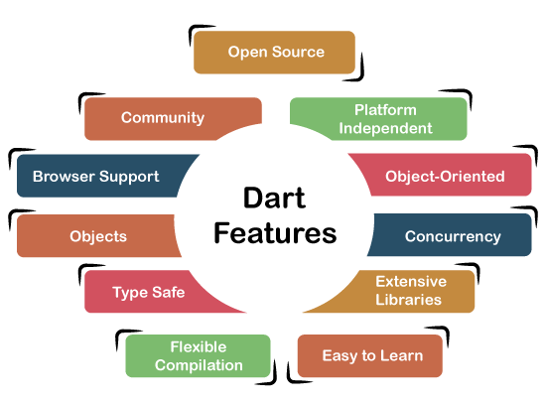
features
The Dart is an object-oriented, open-source programming language which contains many useful features. It is the new programming language and supports an extensive range of programming utilities such as interface, collections, classes, dynamic and optional typing. It is developed for the server as well as the browser. Below is the list of the important Dart features.

Slide 9
features
Open Source
Dart is an open-source programming language, which means it is freely available. It is developed by Google, approved by the ECMA standard, and comes with a BSD license.
Platform Independent
Dart supports all primary operating systems such as Windows, Linux, Macintosh, etc. The Dart has its own Virtual Machine which known as Dart VM, that allows us to run the Dart code in every operating system.
Easy to learn
As we discussed in the previous section, learning the Dart is not the Hercules task as we know that Dart's syntax is similar to Java, C#, JavaScript, kotlin, etc. if you know any of these languages then you can learn easily the Dart.

Slide 10
features
object-Oriented
Dart is an object-oriented programming language and supports all oops concepts such as classes, inheritance, interfaces and optional typing features. It also supports advance concepts like mixin, abstract, classes, reified generic, and robust type system.
Extensive Libraries
Dart consists of many useful inbuilt libraries including SDK (Software Development Kit), core, math, async, math, convert, html, IO, etc. It also provides the facility to organize the Dart code into libraries with proper namespacing. It can reuse by the import statement.

Slide 11
features
Flexible Compilation
Dart provides the flexibility to compile the code and fast as well. It supports two types of compilation processes, AOT (Ahead of Time) and JIT (Just-in-Time). The Dart code is transmitted in the other language that can run in the modern web-brewers.
Type Safe
The Dart is the type safe language, which means it uses both static type checking and runtime checks to confirm that a variable's value always matches the variable's static type, sometimes it known as the sound typing.

Slide 12
features
Although types are required, type annotations are optional because of type interference. This makes it code more readable. The other advantage to being type-safe language is, when we change the part of code, the system warns us about that modification that we have modified earlier.
Objects
The Dart treats everything as an object. The value which assigns to the variable is an object. The functions, numbers, and strings are also an object in Dart. All objects inherit from Object class.

Slide 13
features
Browser Support
The Dart supports all modern web-browser. It comes with the dart2js compiler that converts the Dart code into optimized JavaScript code that is suitable for all type of web-browser.
Community
Dart has a large community across the world. So if you face problem while coding then it is easy to find help. The dedicated developers' team is working towards enhancing its functionality.

Slide 14
Dart installation:-
Install the Dart SDK on Windows
Follow the below instructions to install Dark SDK in Windows.
Step -1: Go to the browser and type the following link to download the SDK.
https://www.gekorm.com/dart-windows/

Slide 15
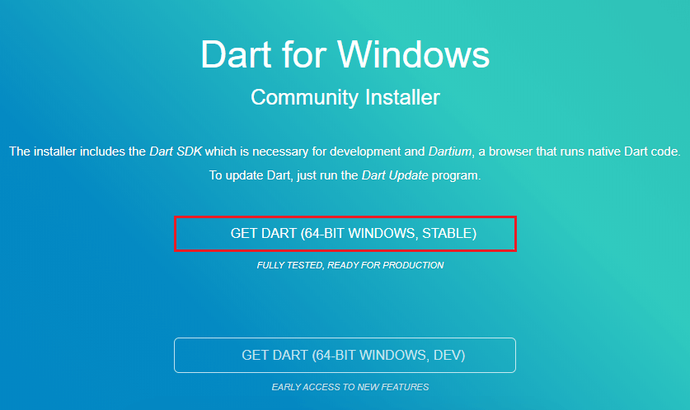
Dart installation:-
It will open the given page. Click on the following link.

Slide 16
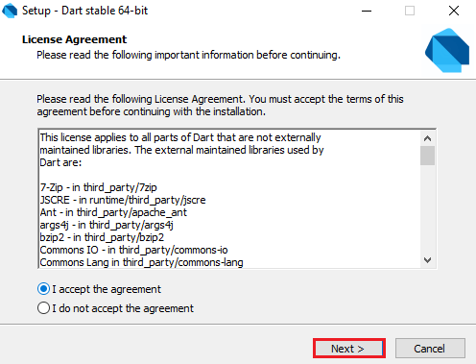
Dart installation:-
Step - 2: Run the Dart installer(It is the .exe file that we downloaded in the previous step) and click on the Next button.

Slide 17
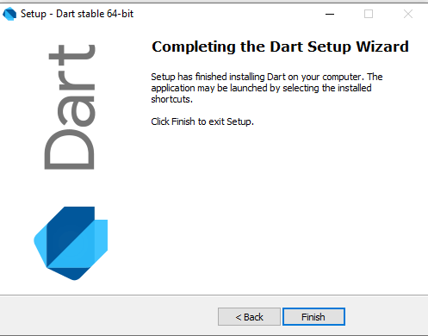
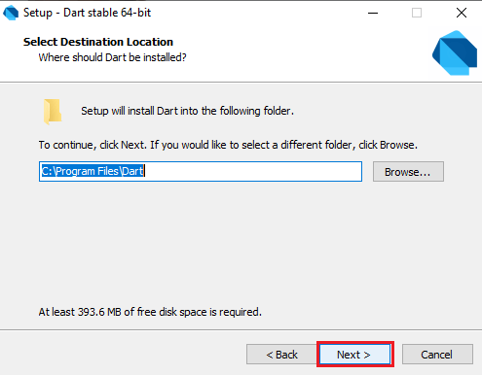
Dart installation:-
Step - 3: It provides the option to select the Dart installation path. After the path is selected, click on the Next button

Slide 18
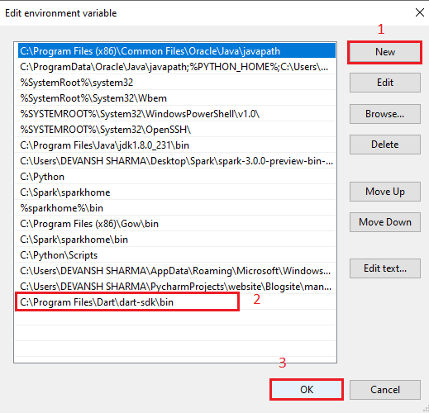
Dart installation:-

Slide 19
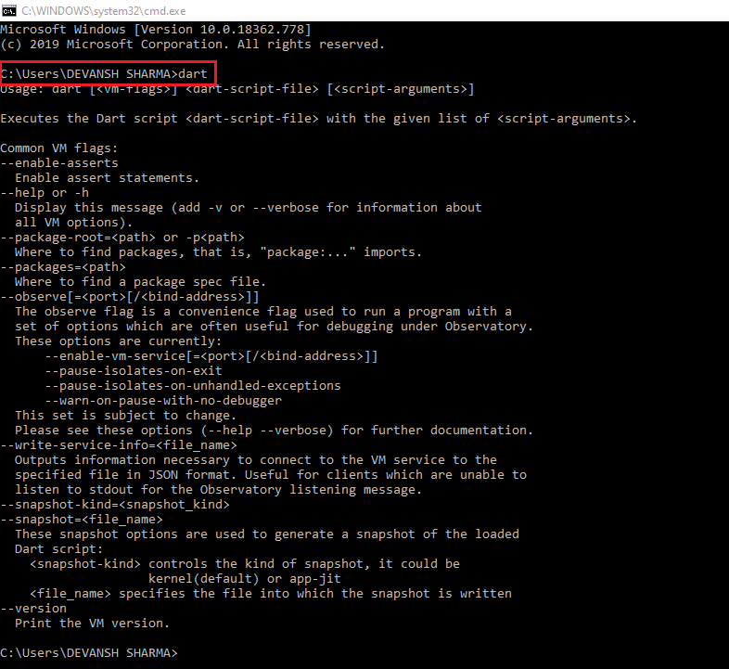
Dart installation:-
Step - 5: Now open the terminal and verify the Dart installation by typing dart.

Slide 20
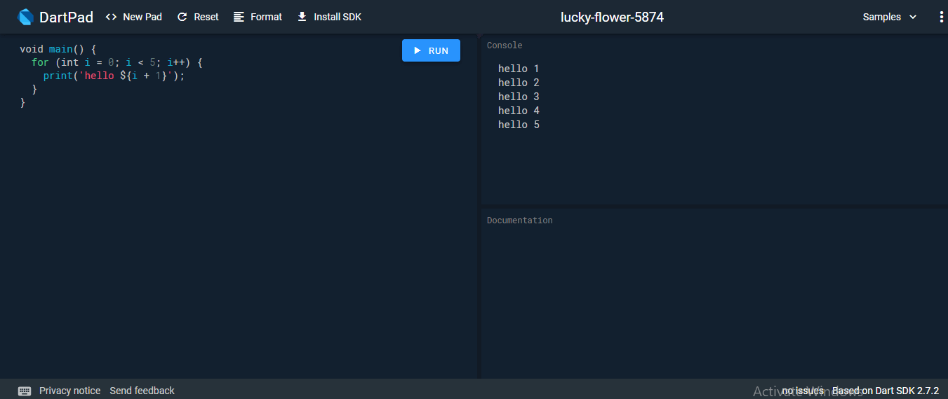
Online editor
We have discussed Dark installation on the various operating systems so far, but if we do not want to install Dart then there is an online Dark editor (Known as DartPad) is available to run the Dark programs. The online DartPad is provided at https://dartpad.dev/ The DartPad offers to execute the dart scripts and display HTML and also console output. The online DartPad looks like the below image.

Slide 21
First program
Dart First Program:-
Dart is easy to learn if you know any of Java, C++, JavaScript, etc. The simplest "Hello World" program gives the idea of the basic syntax of the programming language. It is the way of testing the system and working environment. In this tutorial, we will give the basic idea of Dart's syntax. There are several ways to run the first program, which is given below:
Using Command Line
Running on Browser
Using IDE

Slide 22
First program
main() - The main() function indicates that it is the beginning of our program. It is an essential function where the program starts its execution.
print() - This function is used to display the output on the console. It is similar to C, JavaScript, or any other language. The curly brackets and semicolons are necessary to use appropriately.
Step - 3:
Open the command line; compile the program run the Dart program by typing dart helloworld.dart. It will show Hello World on the screen.

Slide 23
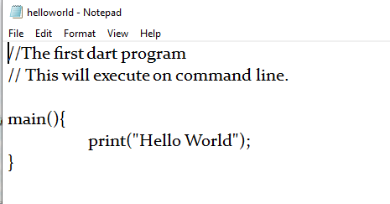
First program

Slide 24
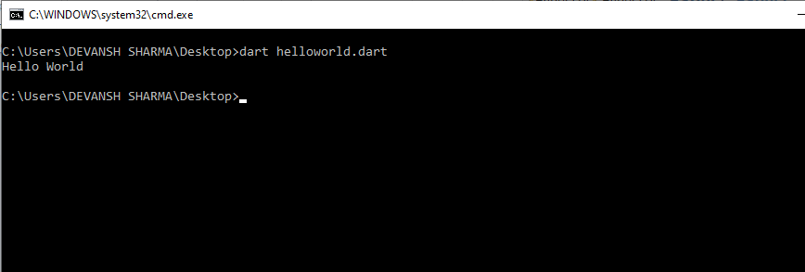
Output:-

Slide 25
Advantages
1. The first advantage is that it is easy to learn. Any JavaScript programmer can quickly relearn how to write code in Dart. To do this, they only need to familiarize themselves with the basic principles of this programming language.
2. The second thing is about its availability of documentation. Since Google is developing the interpreter for Dart, all the features of the language are described in detail. This allows you to quickly get answers to almost any questions that may arise during the training process, or directly while writing code.
3.The third advantage is its high performance. Programs written in Dart tend to run faster than programs created in JavaScript.

Slide 26
Advantages
4. Dart is very stable and it can be used to build production quality real-time applications. It is an object-oriented programming language with support for inheritance, interfaces and optional typing features.
5. It uses AOT and JIT compilation – Dart has the unique capability to handle both Ahead of time and Just in time compiling. In AOT, the Dart code can be directly converted into native machine code. While in the mode of JIT, it can be compiled for exceptionally fast development cycles and game-changing workflow.
6. If you want to start writing your first Dart program without any installation or configuration, there is DartPad for you. The DartPad interface is plain and simple. Write your code and click ‘Run’ to execute the code. DartPad introduces users to the world

Slide 27
Disadvantages
1. The first drawback is that Dart has very limited resources online and it’s hard to find solutions to problems. The reason for it is lack of a larger and cohesive developer communities, which will support you.
2. Dart is fairly new to the programmers and rarely used in the market. So if you will look for a job on this position, it will be harder to find a company with a vacancy of Dart programmer, because it hasn’t yet spread widely.
3.Dart is currently in development. That’s exciting, and it’s not something “wrong” with Dart, but if you start developing in Dart now, there’s a certain chance that the API will change, or that things won’t be documented fully or correctly, and the amount of information on the web is less than, for example, the amount you can find about jQuery.

Slide 28
Disadvantages
4.The absence of native support. For a beautiful demonstration of dart’s capabilities, developers must bring it to users’ browsers. It turns out that to achieve at least 80% success, Dart developers must provide native support for it in all popular browsers.
5.To sum up, Dart is an interesting programming language with features to facilitate Web, mobile and command line apps. Its major advantages are its stability and ease of learning. In the case of Web applications, the combination with AngularDart makes it a very powerful tool. Generally, we think that despite its novelty, this programming language is worth your attention.

Slide 29
Conclusion
Dart is solid choices for developing cross-platform mobile apps as they are being used in React Native and Flutter respectively. Dart is fairly new in comparison with JavaScript, but it has some cool features and great support from Google. At the moment, we can’t guess which one will dominate the future, but it’s sure that Dart has taken off very strongly.

Slide 30
BIBLIOGRAPHY
https://www.javatpoint.com/dart-programming
https://www.geeksforgeeks.org/dart-tutorial/
https://www.tutorialspoint.com/dart_programming/index.htm

Slide 31
Thank you

